Slide 1
CHURN SCORE PREDICTION USING LINEAR REGRESSION
GROUP - 7

Slide 2
INTRODUCTION
In this project, we explore a dataset from a fictional telco company that catered to 7043 customers in California. Our objective is to understand and predict customer churn – the phenomenon where customers discontinue services.
We aim to leverage regression modeling techniques to unravel the factors influencing customer churn. By examining historical data and customer attributes, our goal is to develop a robust predictive model that aids in identifying potential churners.
Through this modelling we can understand the significance of customer retention, and witness the power of predictive analytics in shaping strategic business decisions.

Slide 3
FOCUS AREA
The primary focus of our project is to develop a robust predictive model for customer churn using regression techniques.
We aim to find the factors contributing to customer churn within the telecommunications industry, employing exploratory data analysis to identify patterns and correlations.
Through the application of regression models, we seek to predict churn based on various customer features, engaging in feature engineering, model training, and evaluation.
The project's significance lies in providing actionable insights for the telco sector to enhance customer satisfaction and implement effective retention strategies.
Our expected outcomes include a finely tuned predictive model, a comprehensive understanding of key retention factors, and strategic recommendations to mitigate churn.

Slide 4
DATASET OVERVIEW
The Telco customer churn dataset utilized in this project was obtained from Kaggle. This dataset encapsulates details about a hypothetical telecommunications company serving 7043 customers in California.
Our dataset portraits a picture of Telco customers, offering insights into their geographical locations, tenure with the company, usage of services like phone and internet, contract types, billing preferences, and payment methods.
Each entry is associated with a unique Customer ID, and the dataset includes a Churn Label indicating whether the customer has churned (0 for No, 1 for Yes) and a Churn Score representing the probability percentage of Churn Score.

Slide 5
FEATUREs OVERVIEW
The dataset contains 33 columns providing detailed insights into the customer base of a fictional telecom company.
Key demographic information such as customer location, gender, and senior citizen status is included.
The dataset also delves into the specifics of services subscribed to, including phone and internet services, with details on the type of internet connection and additional features like online security and streaming services.
Contract terms, billing preferences, payment methods, and financial aspects like monthly and total charges are thoroughly documented. The churn-related columns, including churn label and churn score, offer a crucial perspective on customer retention.
Moreover, the dataset also contains Customer Lifetime Value (CLTV) index and reasons for customer churn, contributing to a comprehensive understanding of customer dynamics within the telecommunications domain

Slide 6

DATA PREPROCESSING
Converting column names and values
Missing Value Analysis
Dropping redundant columns
Type Casting

Slide 7
DATA PREPROCESSING
Converting column names and values
Convert column names into lower case and replace hyphen or empty spaces with underscore
Missing Value Analysis
There were no missing values found in the dataset.
Dropping redundant columns
Dropped columns like Customer ID, Country, State, Churn Reason etc..., which were not relevant for model building
Type Casting
Total Charges where considered as a string type and hence changed it to float.

Slide 8
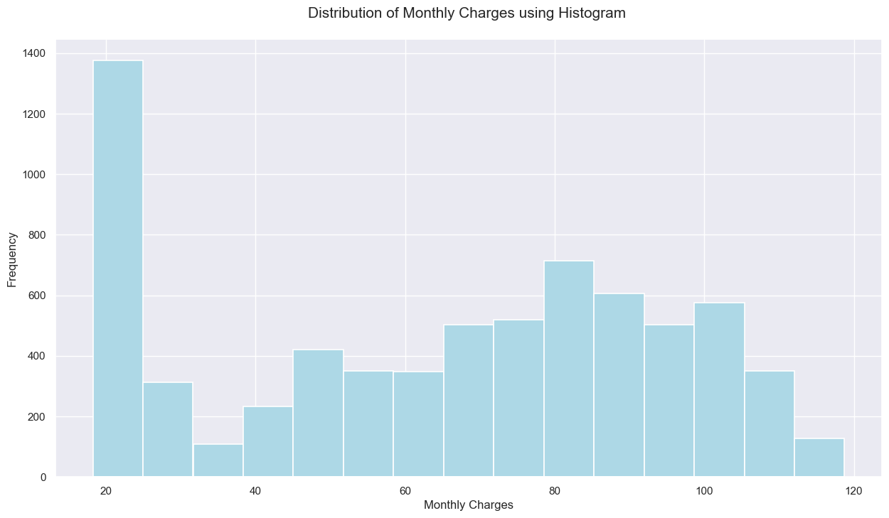
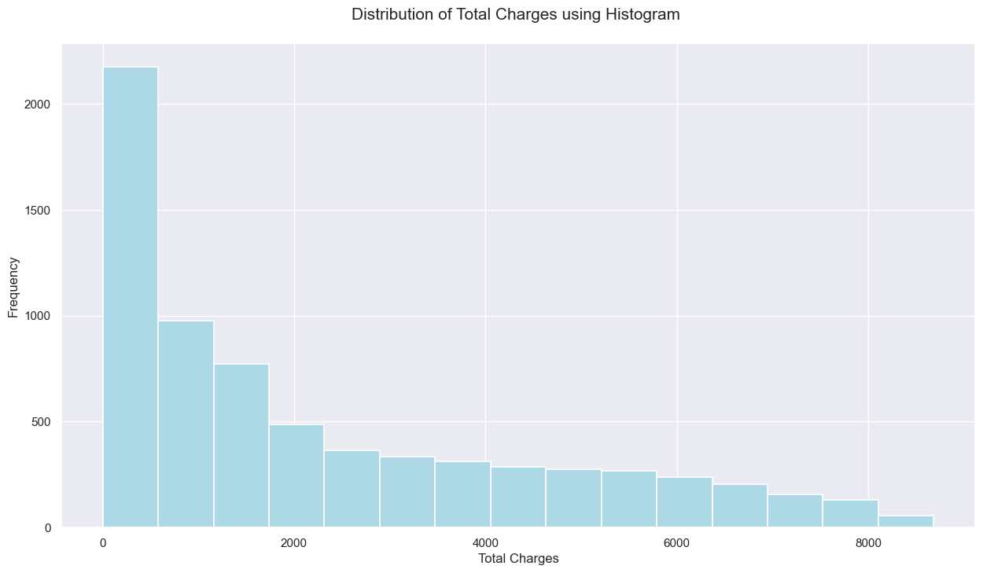
UNIVARIATE ANALYSIS
The distribution of monthly charges and total charges is right-skewed.
The positive/right skew indicates that more customers pay a higher fee, resulting in the mean being pulled to the right of the median.

Slide 9
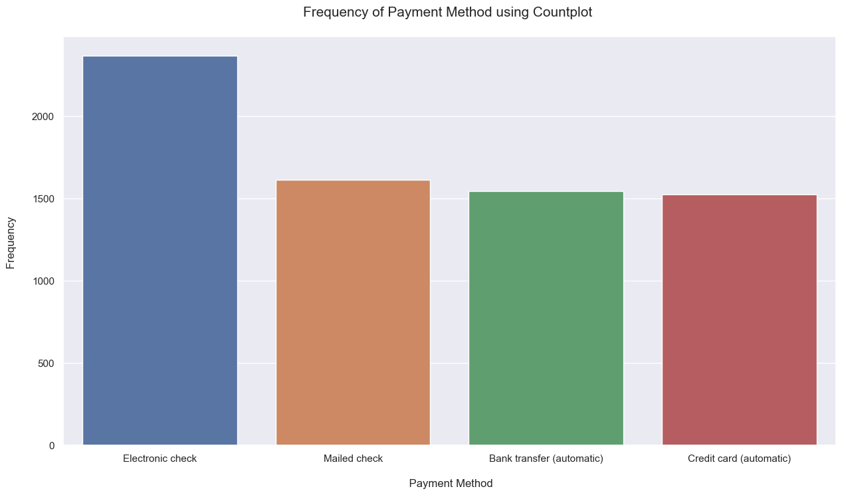
UNIVARIATE ANALYSIS
Most of the customers pay using electronic checks.
The rest of the three payment methods have almost the same count.

Slide 10
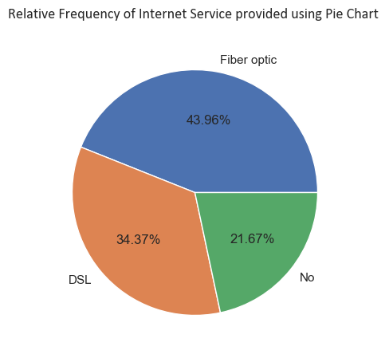
UNIVARIATE ANALYSIS
Only 21% of the total customers don't use internet services.
Approximately 50% of the customers use fiber optics for internet connectivity.

Slide 11
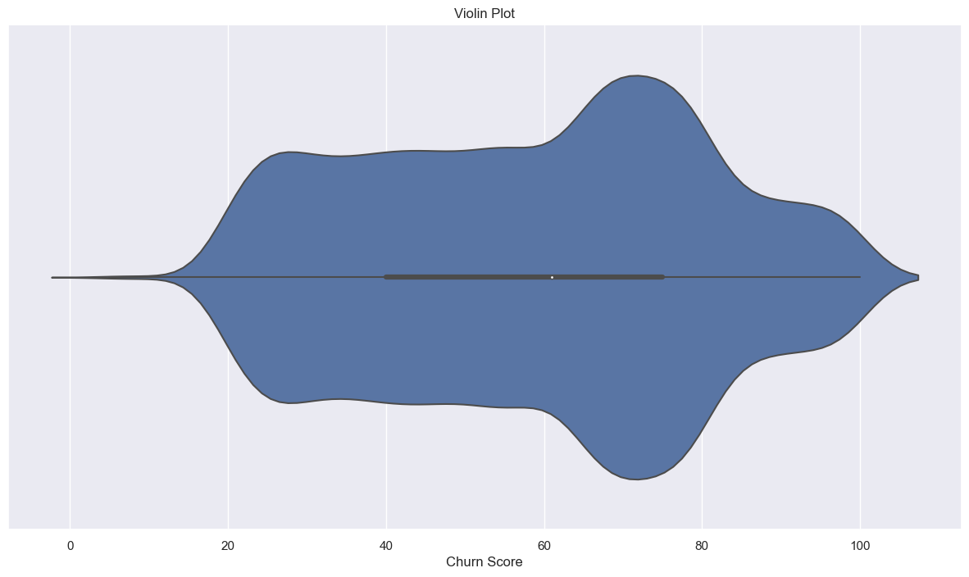
UNIVARIATE ANALYSIS
Majority of customers cluster around a churn score between 60 to 80.
The distribution of churn scores shows a slight leftward skewness.

Slide 12
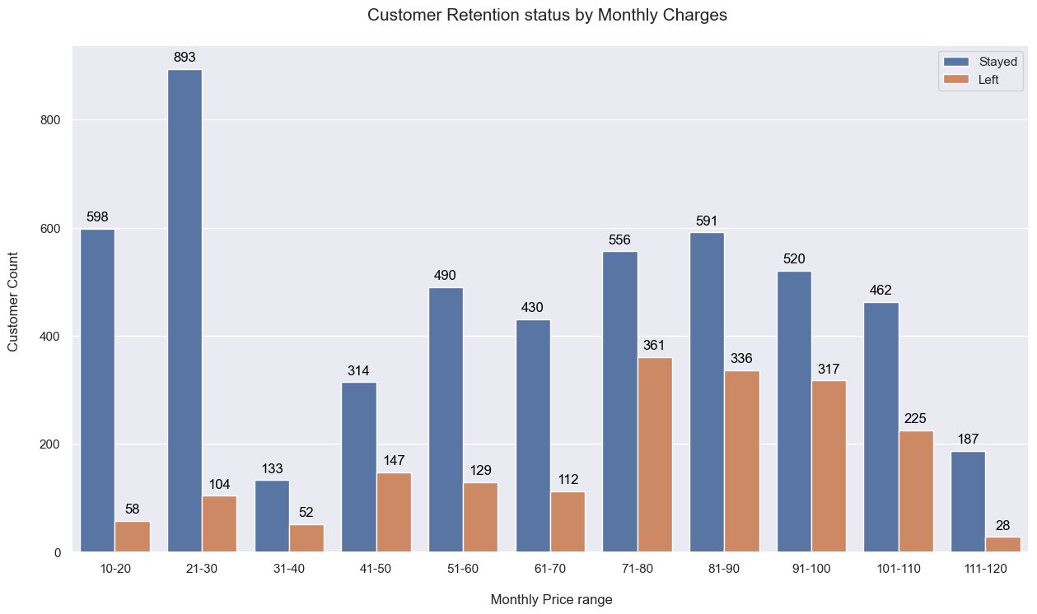
BIVARIATE ANALYSIS
The majority of customer retention can be seen at the monthly price range of 21–30 of those staying with the telecom partner.
However, we can see that customers in the monthly rates of 10–21 and 71–100 are also staying with the operator, but in those ranges, we can see a lot of customers opting for other telecom operators.

Slide 13
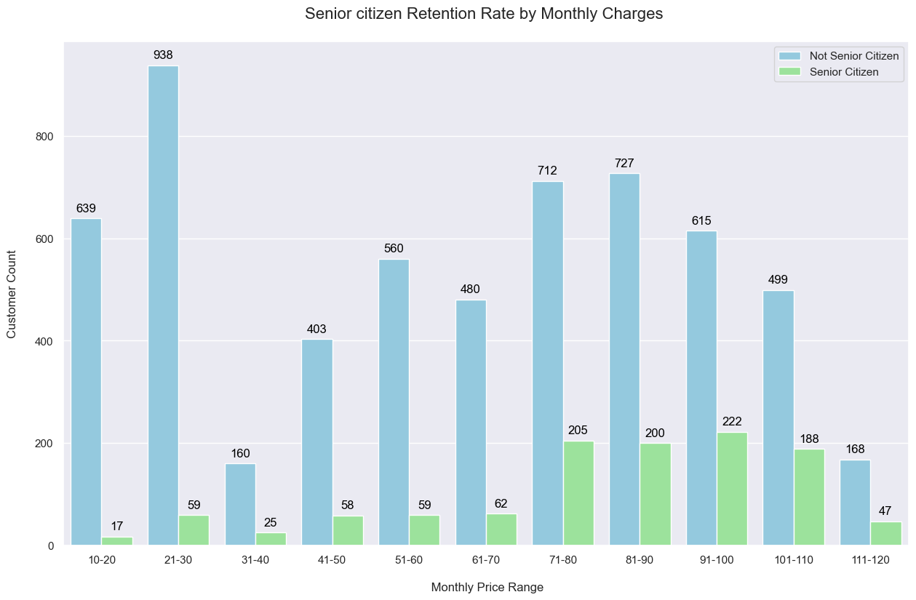
BIVARIATE ANALYSIS
From the count plot, we can understand that the individuals who are not senior citizen customers are mostly staying consistent with the telecom partners.
Moreover, the majority of the customers are interested in a monthly price range of 21–30.
We can conclude that the best price range for the telecom operator would be 21–30.

Slide 14
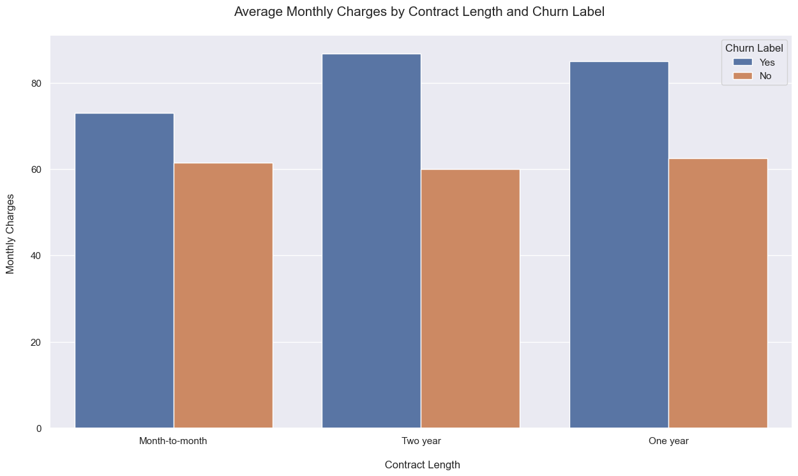
MULTIVARIATE ANALYSIS
When considering the average monthly charges by contract, the percentage of customers who churned is similar in all the categories.
The plot clearly shows that monthly charges don't affect the churning of customers when compared with contract length.

Slide 15
MODELLING DISTRIBUTIONS
For Telco customer data we consider the churn value for analysis modeled using binomial distribution
n : Total number of customers
p : Probability that the customer will stay.
Each customer in the dataset can be considered like a little test. Did they leave or not? This is like asking a question for each customer: 'Did they churn?' The binomial distribution helps us see patterns in these 'yes' or 'no' situations, helping us understand customer churn better.

Slide 16
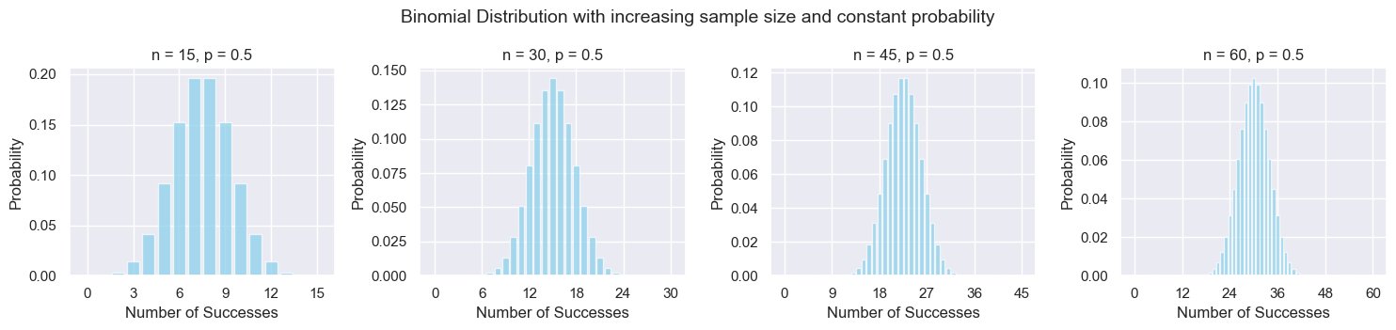
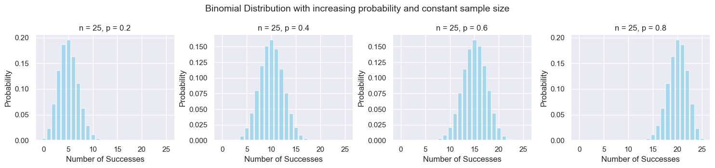
BINOMIAL DISTRIBUTION
As n increases the spread of the distribution decreases and gets concentrated around the mean.
As p increases the shape of the distribution changes from right skewed to approximately symmetrical to left skewed.

Slide 17
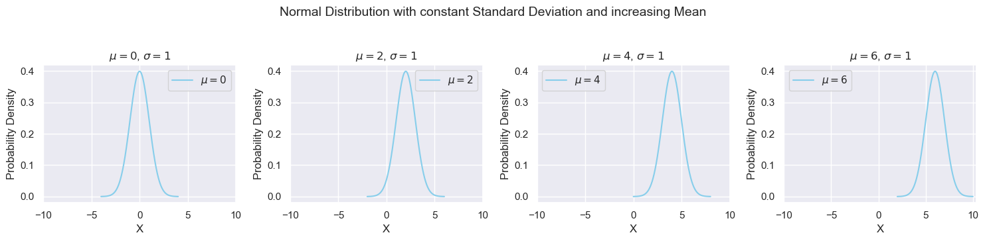
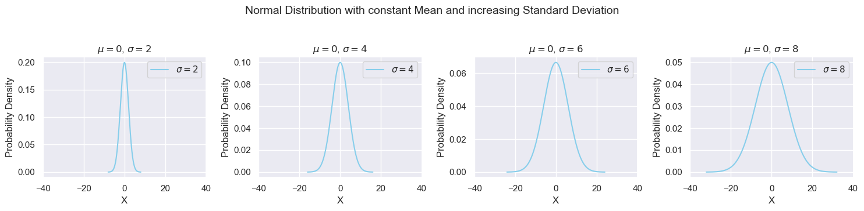
NORMAL DISTRIBUTION
As μ increases the entire distribution shifts to the right along the x-axis.
As σ increases the spread of the distribution increases and the tails stretch outwards.

Slide 18
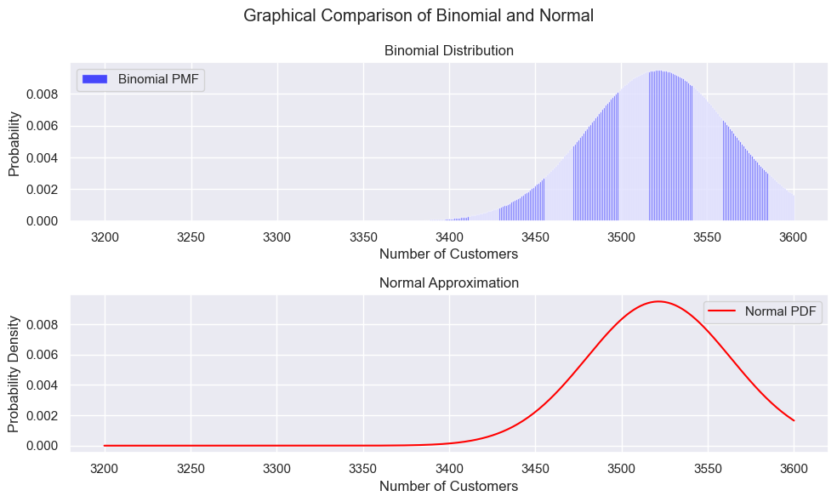
MODELLING DISTRIBUTIONS
Here we are trying to find the probability of 3200 to 3600 customers staying with the company.
For large sample size n , the binomial distribution can be approximated by a normal distribution using the Central Limit Theorem.
μ = np ; σ = ( npq )^0.5 B(𝑛,𝑝) ∼ N(𝜇,𝜎)

Slide 19
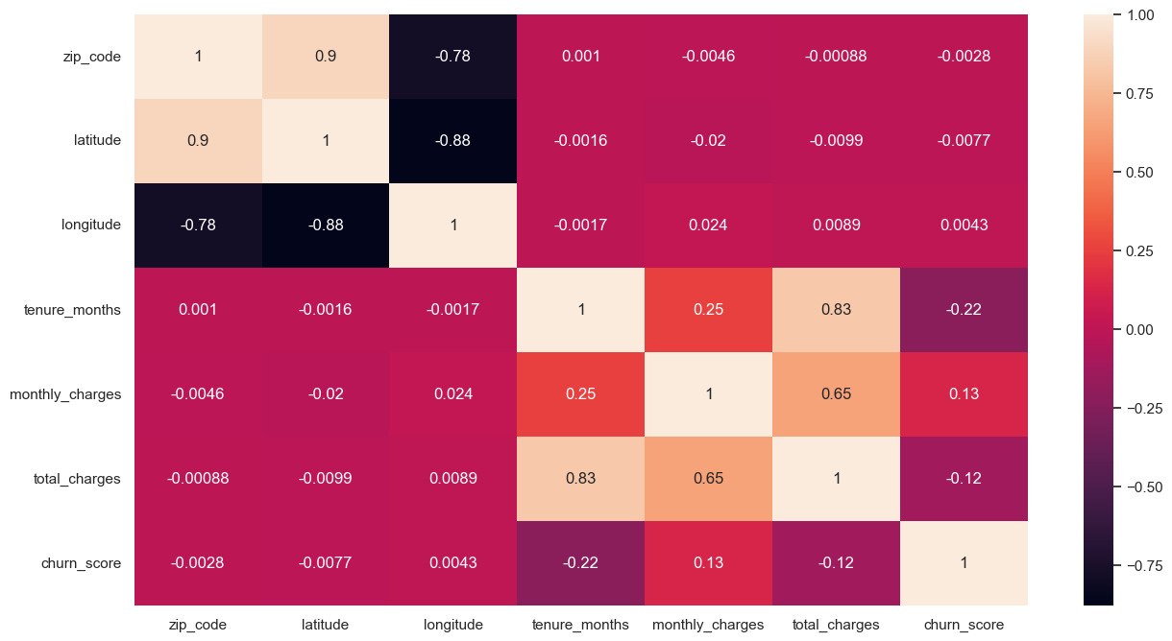
CORRELATION MAP
Tenure Months and Monthly Charges are the features that have a reasonable correlation with churn score.

Slide 20
REGRESSION
Objective: Predicting churn score for improved decision-making.
Importance of Churn Prediction: Enhances customer retention strategies.
Metrics: Using R-squared for model evaluation.

Slide 21
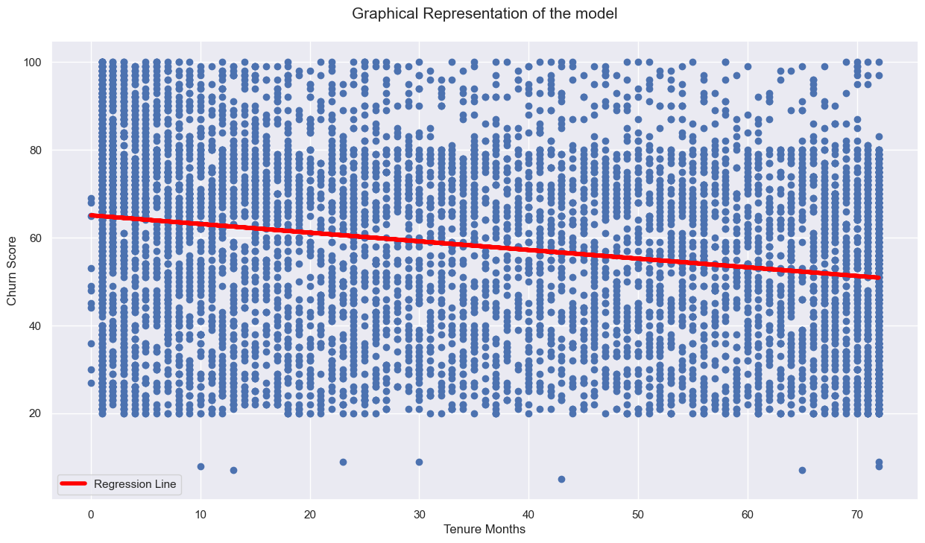
SIMPLE LINEAR REGRESSION - 1
Model Architecture: Simple Linear Regression
Equation: Y = 64.8005 - 0.1971 * Tenure Months
Performance Metrics: R^2 : 0.050
The intercept value for this model is 64.8005. Since we are trying to predict the churn score, which represents the probability score of churn, the intercept is not a good measure for predicting.

Slide 22
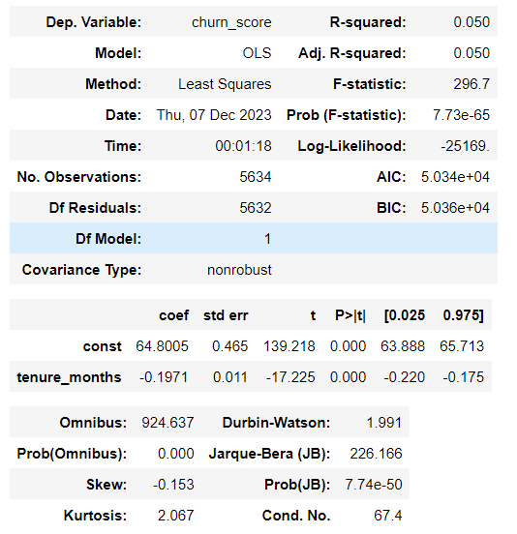
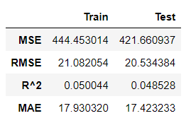
SIMPLE LINEAR REGRESSION - 1
The model seems to have relatively high errors (MSE, RMSE, MAE) on both training and testing sets.
The R^2 values are low, indicating that the model doesn't explain much of the variance in the target variable.

Slide 23
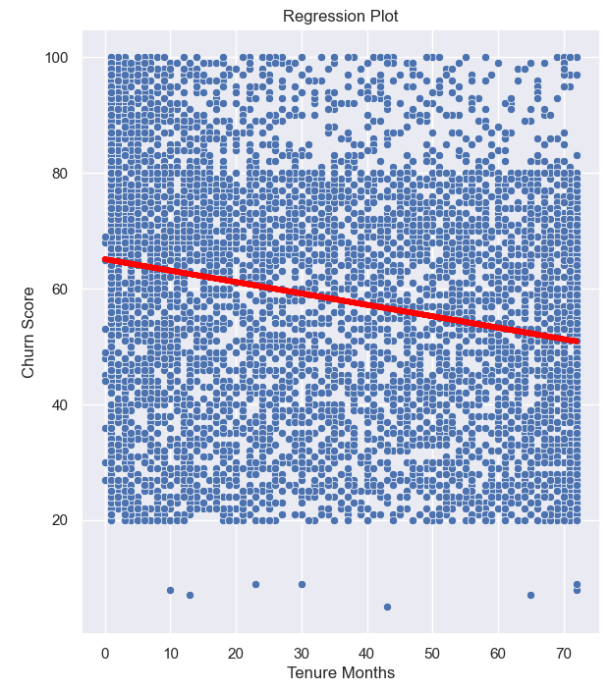
MODEL DIAGNOSTICS
Linearity
There is no linear relationship to be found between Tenure Months and Churn Score.

Slide 24
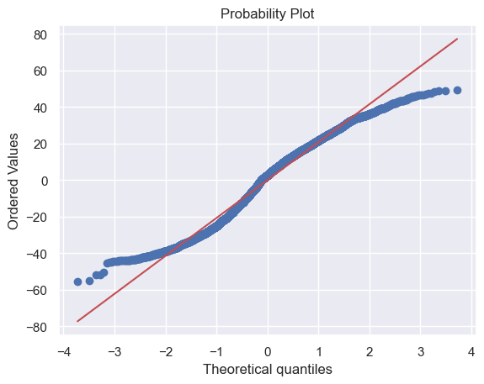
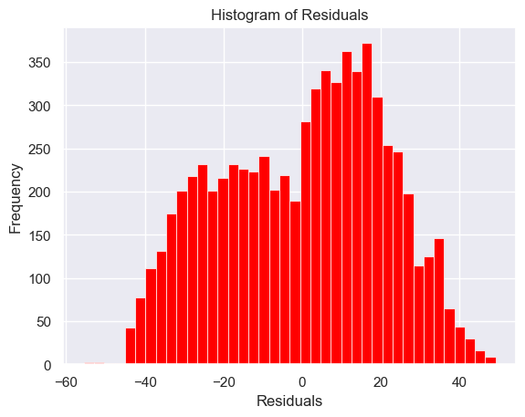
MODEL DIAGNOSTICS
Normality
The residuals are not normally distributed.

Slide 25
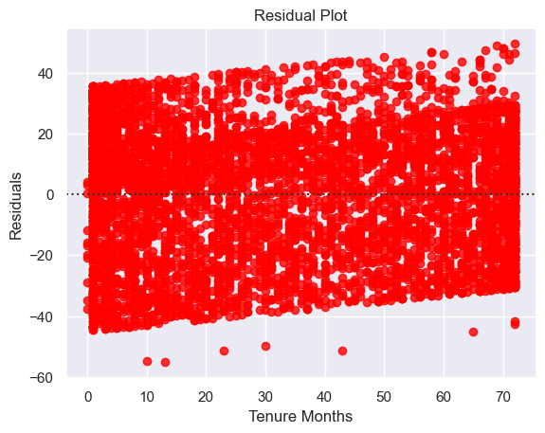
MODEL DIAGNOSTICS
Constant Variability
There is slanting to the left visible in the residual plot.
Since there is a slant we can confirm that the constant variability is not met.

Slide 26
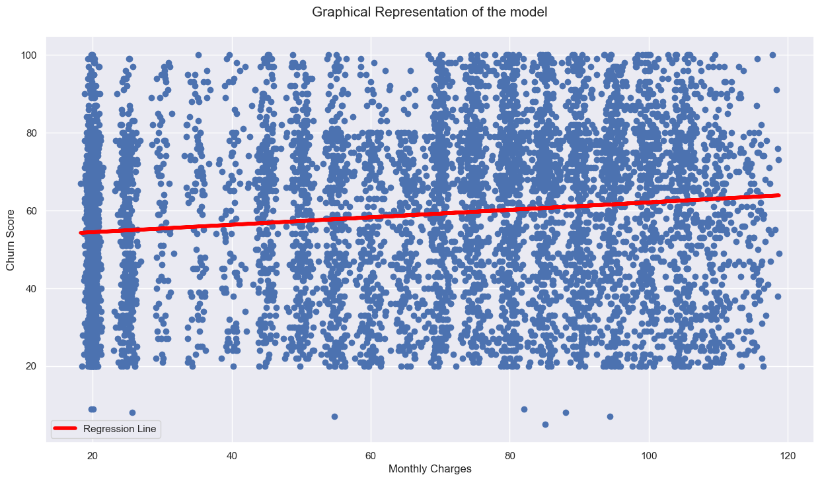
SIMPLE LINEAR REGRESSION - 2
Model Architecture: Simple Linear Regression
Equation: Y = 52.0577 + 0.0986 * Monthly Charges
Performance Metrics: R^2 : 0.019
Intercept : The intercept tells us that a minimum churn score of 52 will be assigned to all the customers by the model.

Slide 27
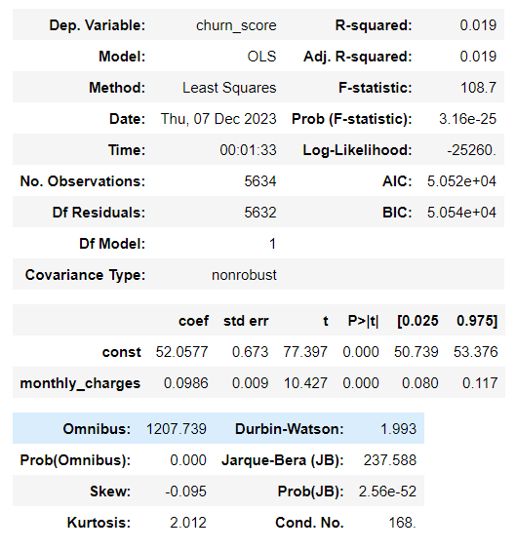
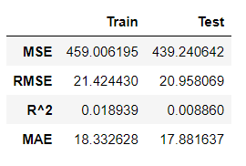
SIMPLE LINEAR REGRESSION - 2
The model seems to have relatively better results during the test phase due to low errors comparing to the training phase.
The R^2 values are low, indicating that the model explained only a small fraction of variance in the target variable.

Slide 28
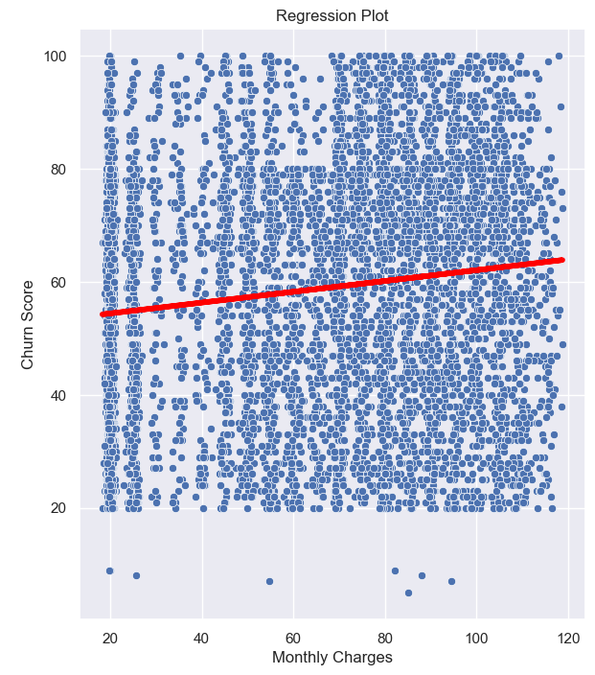
MODEL DIAGNOSTICS
Linearity
There is no linear relationship to be found between Monthly Charges and Churn Score.

Slide 29
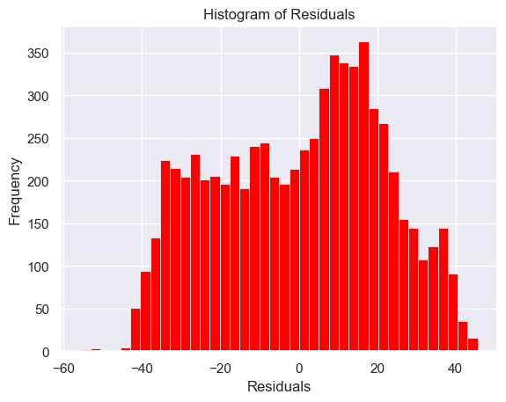
MODEL DIAGNOSTICS
Normality
The residuals are not normally distributed.

Slide 30
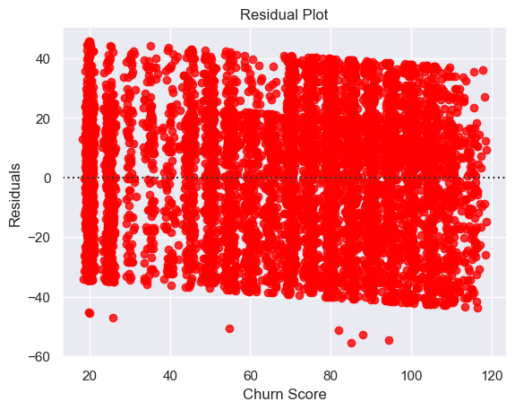
MODEL DIAGNOSTICS
Constant Variability
There is slanting to the right visible in the residual plot.
This illustrates that the constant variability is not met.

Slide 31
MULTIPLE LINEAR REGRESSION
Equation: Y = 5.5377 + 0.0003 * X1 + … - 0.2158 * X33
Performance Metrics: R^2 : 0.133
Intercept : The intercept is meaningful considering last two models because as we increase the number of features, there is more variability seen in predictions.

Slide 32
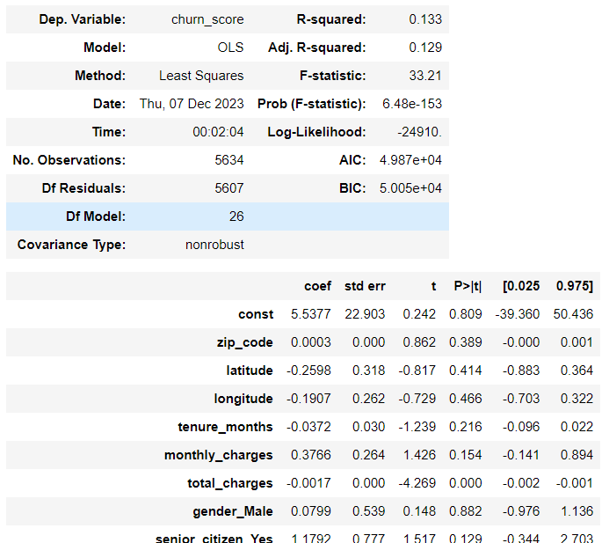
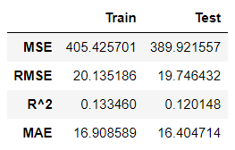
MULTIPLE LINEAR REGRESSION
The model has shown some improvement compared to the last two models. The errors are slightly lower, indicating a better fit to the data.
The R^2 is still low but has increased compared to the last models, suggesting that the model explains a larger portion of the variance in the target variable compared to the last ones.

Slide 33
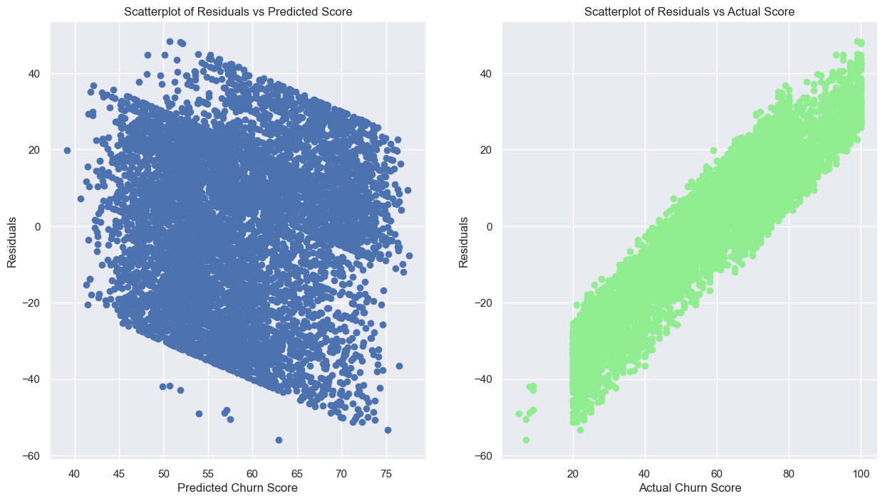
MODEL DIAGNOSTICS
The residuals are showing a banding pattern for Predicted Churn Score. This pattern indicates that the constant variability condition is not met.
The model overestimates lower churn score and underestimates higher churn score values.

Slide 34
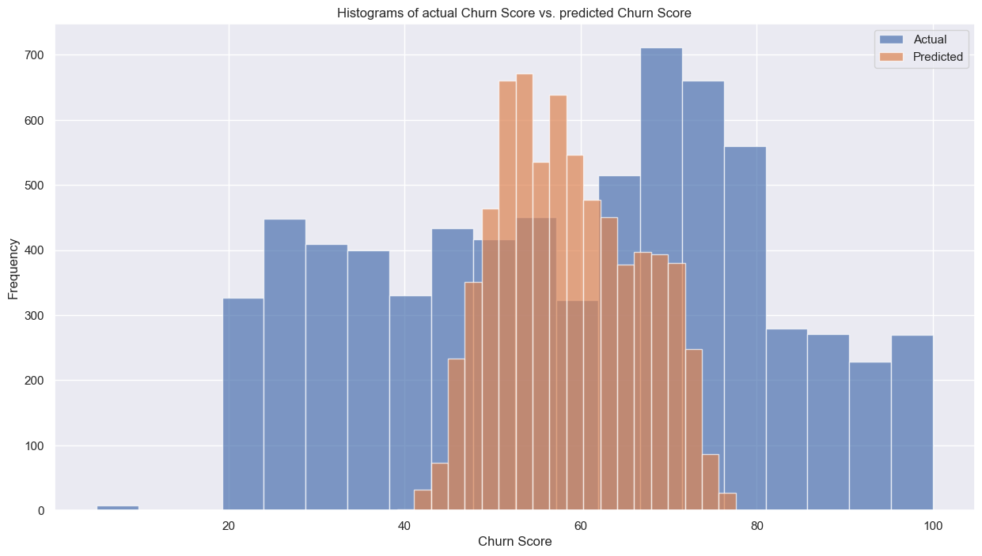
MODEL DIAGNOSTICS
The distribution of both plots are entirely different.
The model predictions are highly clustered around 40 to 80.

Slide 35
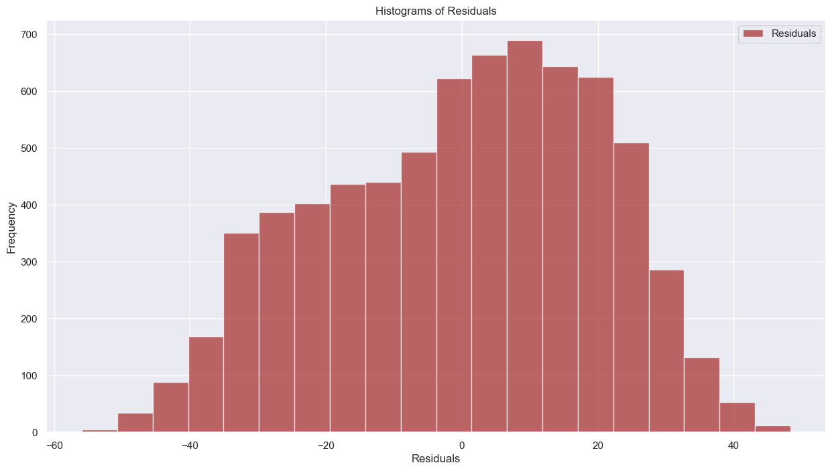
MODEL DIAGNOSTICS
The residuals are nearly normally distributed.

Slide 36
MLR – BACKWARD FEATURE SELECTION
Equation: Y = 35.8808 + 0.2052 × monthly_charges − 0.0021 × total_charges − 4.7557 × dependents_Yes + 16.1816 × phone_service_Yes + 19.6991 × multiple_lines_No_phone_service + 1.4947 × multiple_lines_Yes − 3.1861 × online_security_Yes − 1.7831 × device_protection_Yes − 2.3260 × tech_support_Yes − 3.7759 × contract_One_year − 3.2906 × contract_Two_year + 1.9256 × paperless_billing_Yes + 1.8964 × payment_method_Electronic_check
Performance Metrics: R^2 : 0.132
Backward Feature Selection doesn’t make a change in model performance.

Slide 37
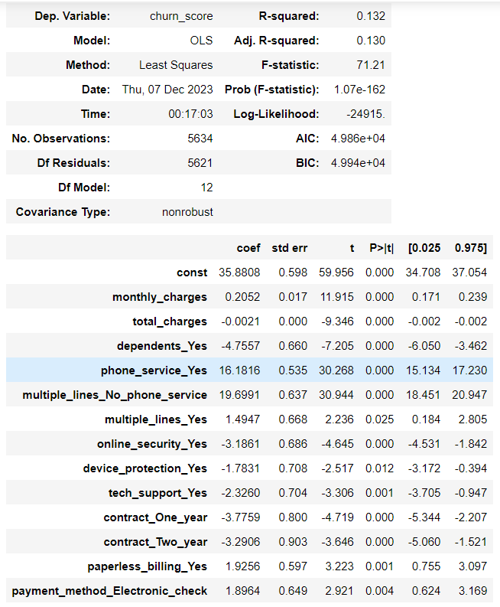
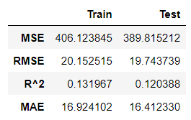
MLR – BACKWARD FEATURE SELECTION
There is no significant change seen in the model even after backward selection.
This suggests that may be non - linear models result in better outcomes.

Slide 38
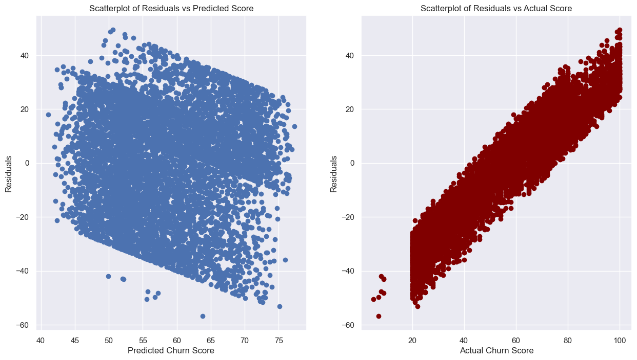
MODEL DIAGNOSTICS
The residuals are showing a banding pattern for Predicted Churn Score. This pattern indicates that the constant variability condition is not met.
The model overestimates lower churn score and underestimates higher churn score values.

Slide 39
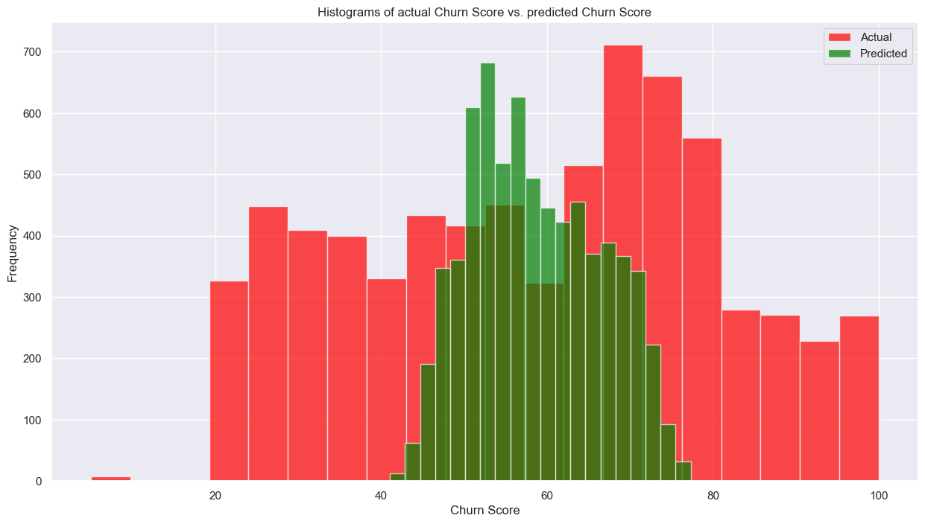
MODEL DIAGNOSTICS
The distribution of both plots are entirely different.
The model predictions are highly clustered around 40 to 80.

Slide 40
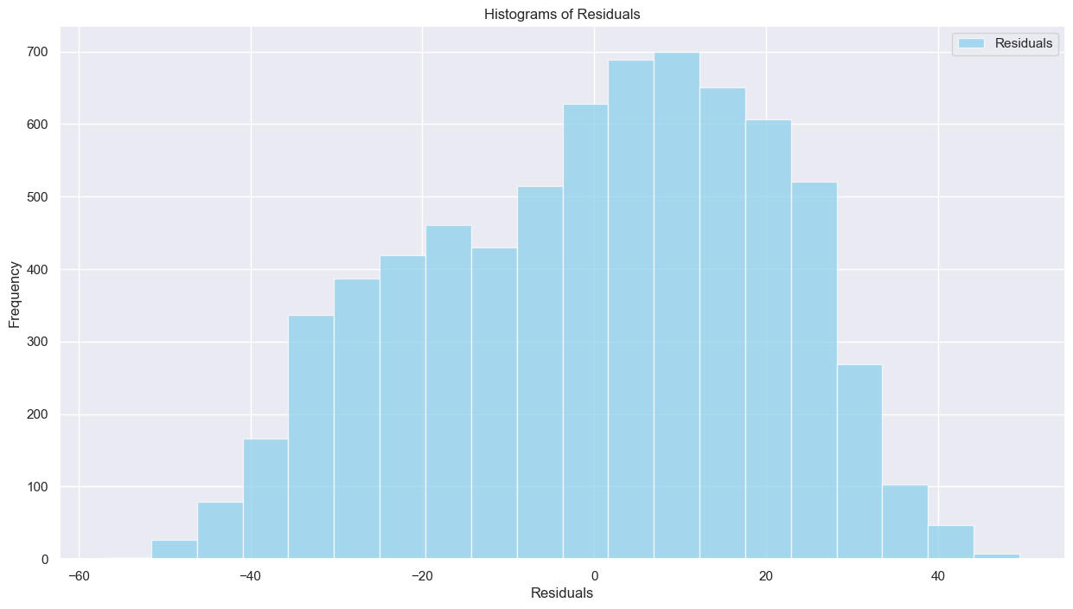
MODEL DIAGNOSTICS
The residuals are nearly normally distributed.

Slide 41
NON – LINEAR REGRESSION
Equation: Y = 39.7306 + 1.226𝑒−05 × monthly_charges^3 − 2.374𝑒−07 × total_charges^2 − 5.1239 × dependents_Yes + 18.4309 × phone_service_Yes + 21.2997 × multiple_lines_No_phone_service + 1.0476 × multiple_lines_Yes − 2.5416 × online_security_Yes − 1.6974 × device_protection_Yes − 1.6795 × tech_support_Yes − 5.6605 × contract_One_year − 5.6557 × contract_Two_year + 2.2607 × paperless_billing_Yes + 2.5022 × payment_method_Electronic_check
Performance Metrics: R^2 : 0.124
Non – linear regression also doesn’t make a change in model performance.

Slide 42
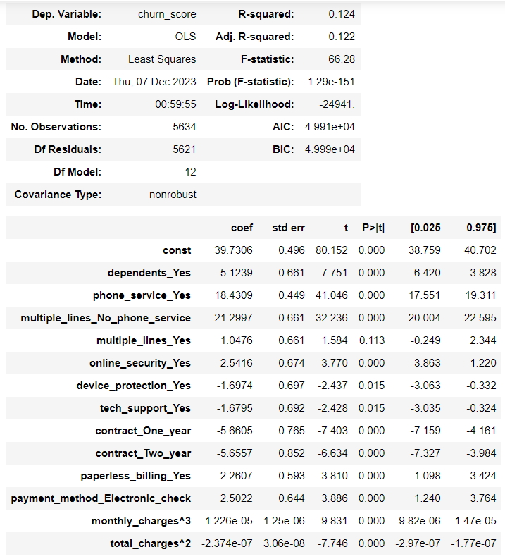
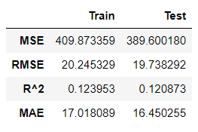
NON – LINEAR REGRESSION
The metrics doesn't have a significant change even after using a non - linear approach.

Slide 43
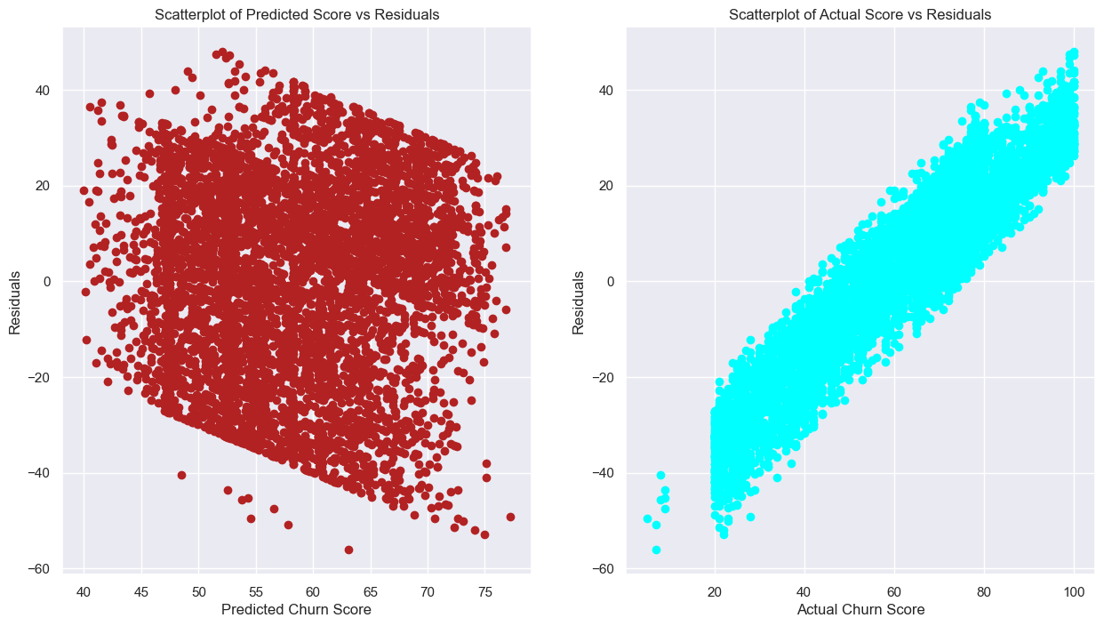
MODEL DIAGNOSTICS
The residuals are showing a banding pattern for Predicted Churn Score. This pattern indicates that the constant variability condition is not met.
The model overestimates lower churn score and underestimates higher churn score values.

Slide 44
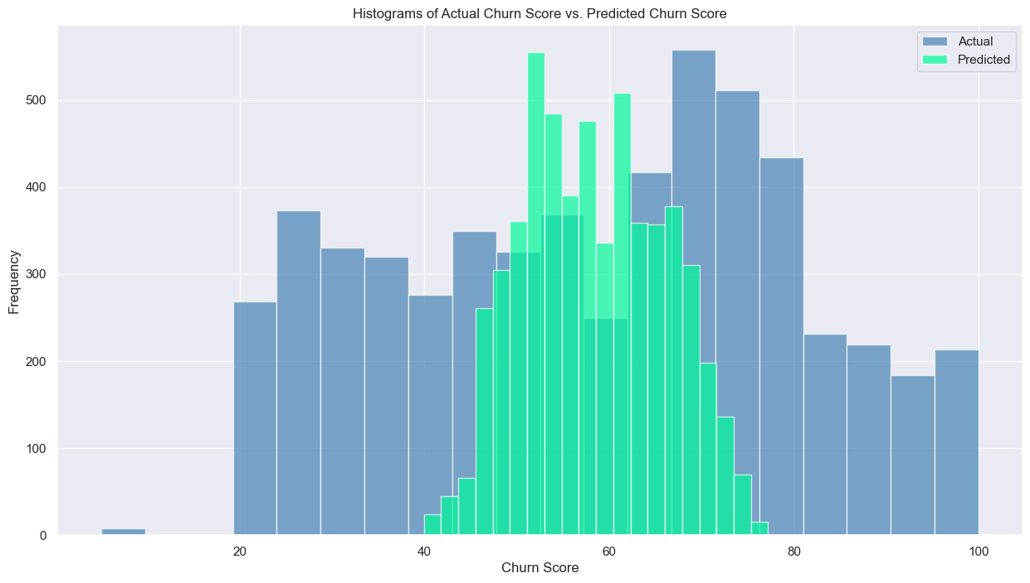
MODEL DIAGNOSTICS
The distribution of both plots are entirely different.
The model predictions are highly clustered around 40 to 80.

Slide 45
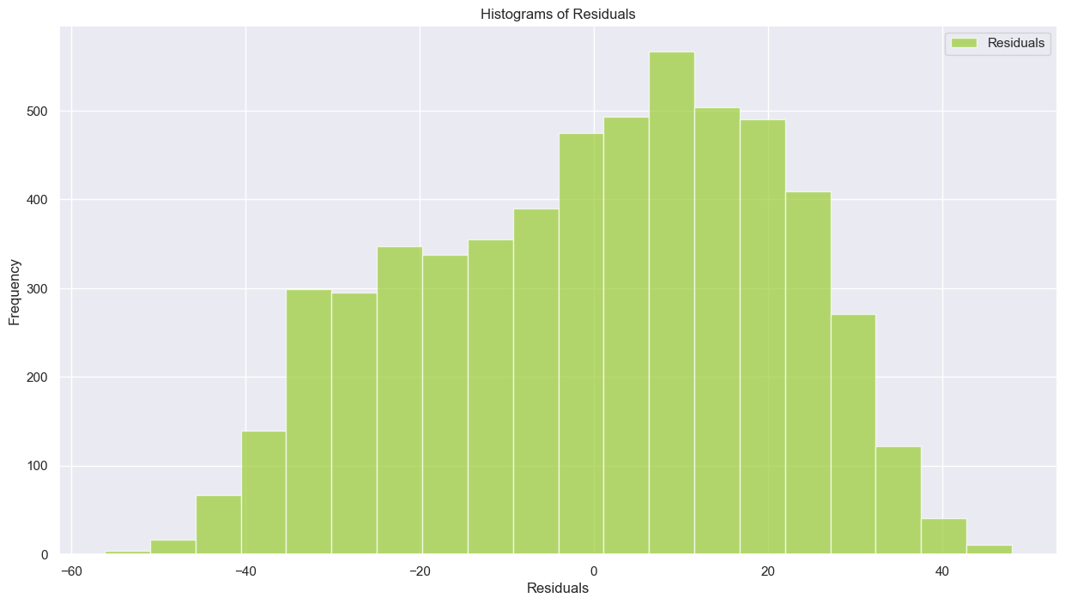
MODEL DIAGNOSTICS
The residuals are nearly normally distributed.

Slide 46
CONCLUSION
The five models, including linear and non-linear approaches, did not result in a significant improvement in predicting churn score.
The R^2 values across models are relatively low, indicating that the models explain only a small portion of the variance in the target variable.
The features considered in these models may not be sufficient to capture the complexities of the underlying patterns, and hence more features may be necessary for a better model building.

